Slide 1
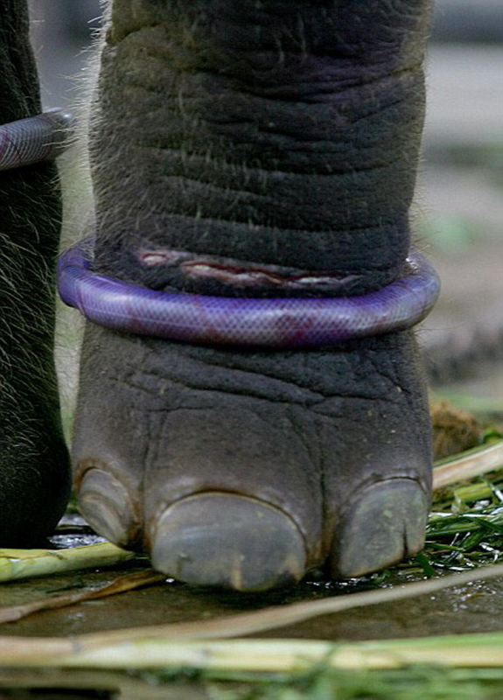
Notes:
Image 1 Photographic Evidence: It is shown the leg of a chained elephant from three of its legs.

Slide 2
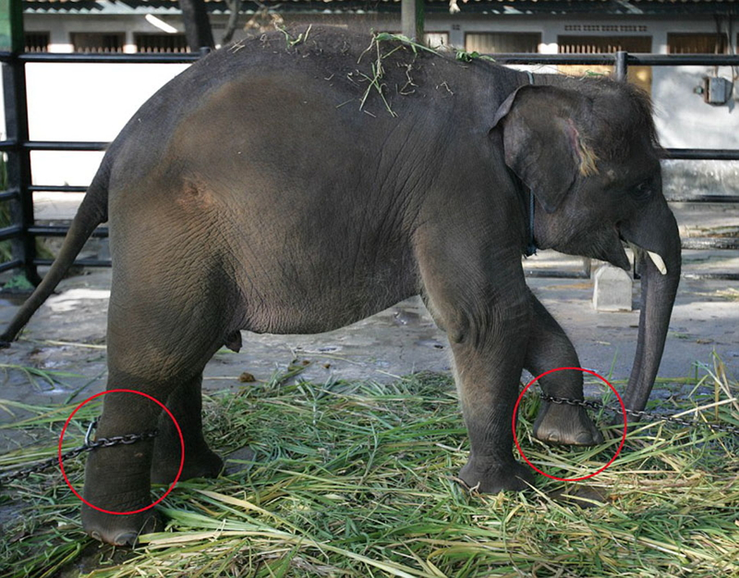
Notes:
Image 2 of the Photographic Evidence: In this picture it is shown an elephant chained from its right rear and left front legs, leaving the animal practically immobilised.

Slide 3
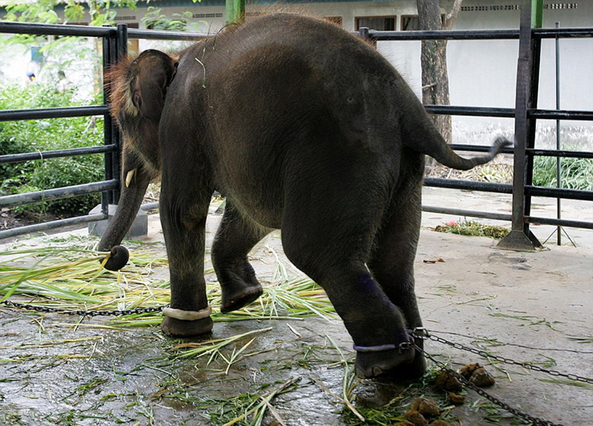
Notes:
Image 3 of the Photographic Evidence: In this image it can be seen the same elephant of the image 1 which is in chains from three of its legs but from another angle.

Slide 4
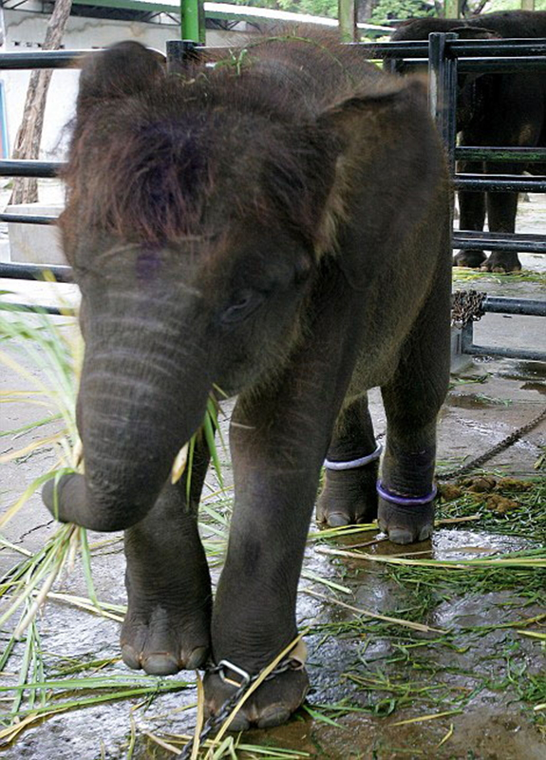
Notes:
Image 4 of the Photographic Evidence: It is observed the elephant of the previous image chained on three legs.

Slide 5
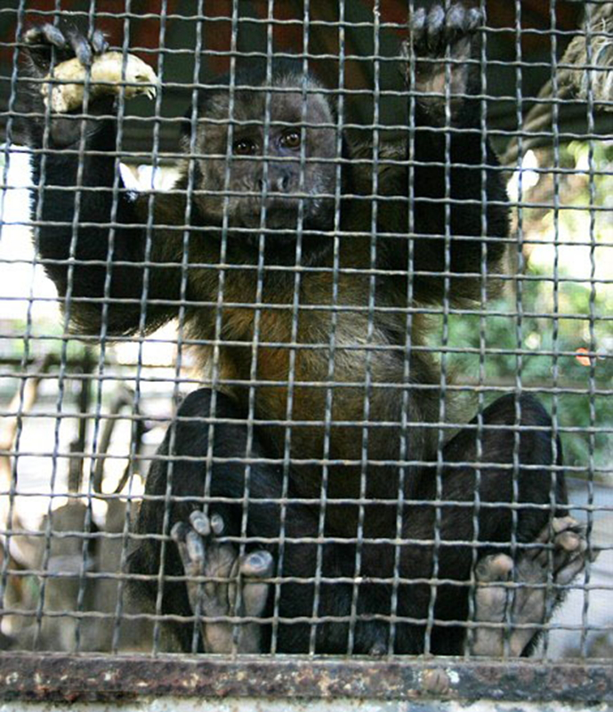
Notes:
Picture 5 of the Photographic Evidence: Here, it can be appreciated the face of sadness of the monkey.

Slide 6
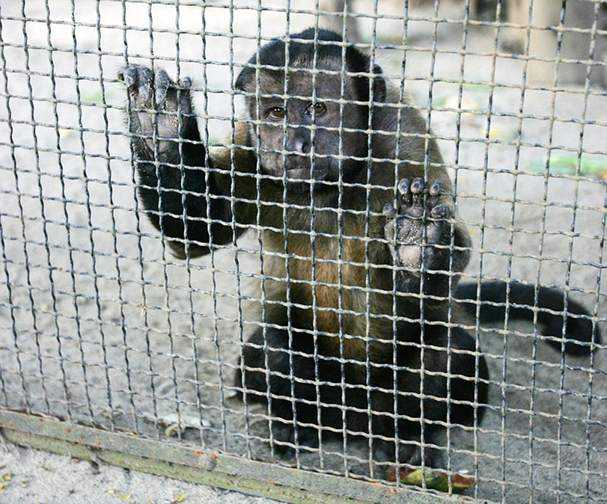
Notes:
Image 6 of the Photographic Evidence: It can seen another of the caged monkeys with a sad expression on its face.

Slide 7
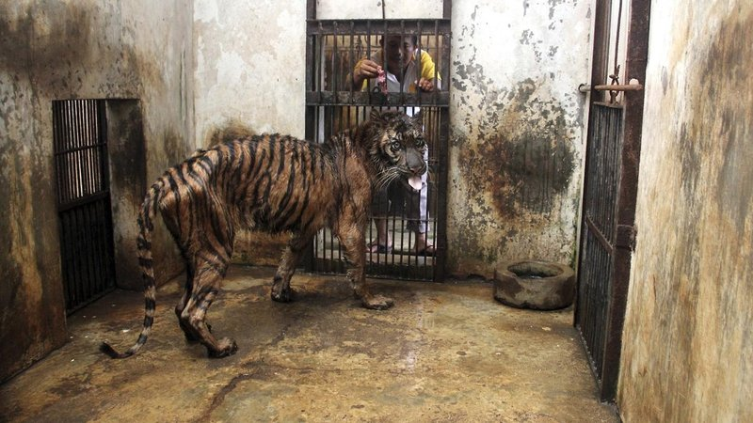
Notes:
Image 7 of the Photographic Evidence: In this picture it can be seen a tiger in captivity, which is in totally unsanitary and unhealthy conditions, besides the limited space in which it is confined.

Slide 8
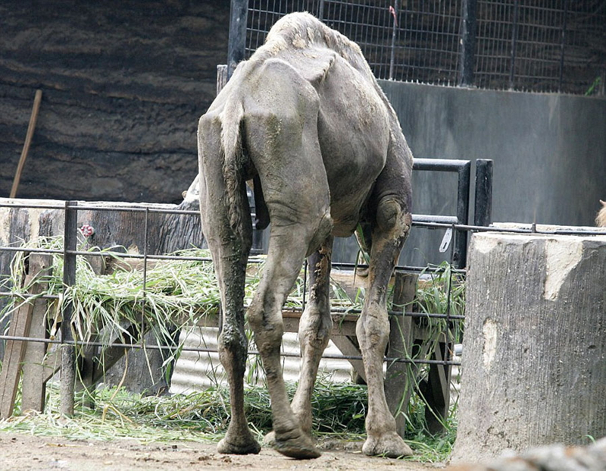
Notes:
Image 8 of the photographic evidence: In this image it is observed what seems to be a dromedary in extreme malnutrition conditions.

Slide 9
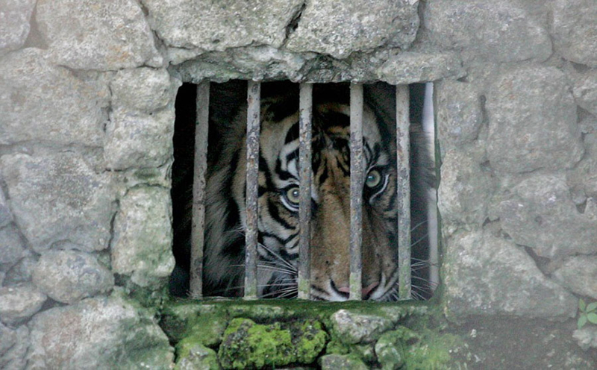
Notes:
Image 9 of the Photographic Evidence: in this picture it can be seen the tiny cage within which this tiger is.

Slide 10
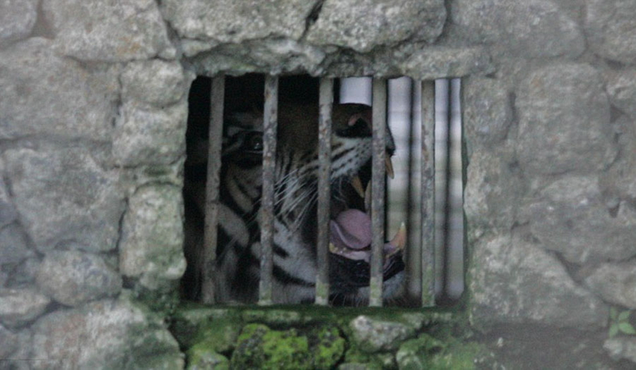
Notes:
Image 10 of the Photographic Evidence: In this image it is also observed the little space of the tiger’s cage.

Slide 11
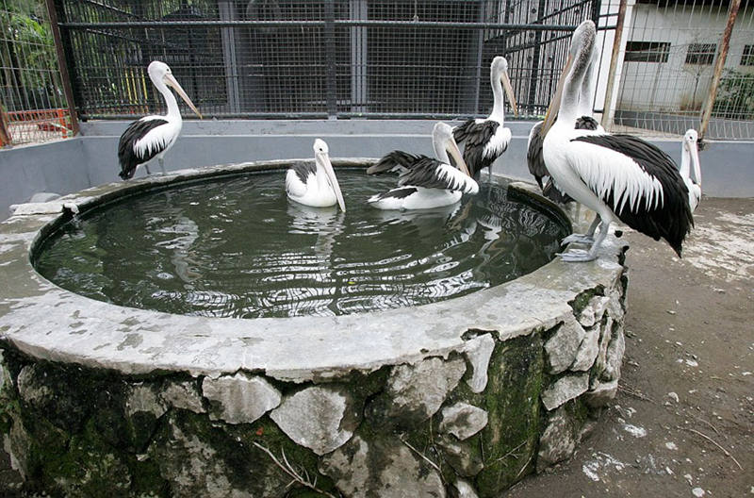
Notes:
Image 11 of the Photographic Evidence: In this image it can be seen a group of pelicans that are in a smaller space than they should be and need.

Slide 12
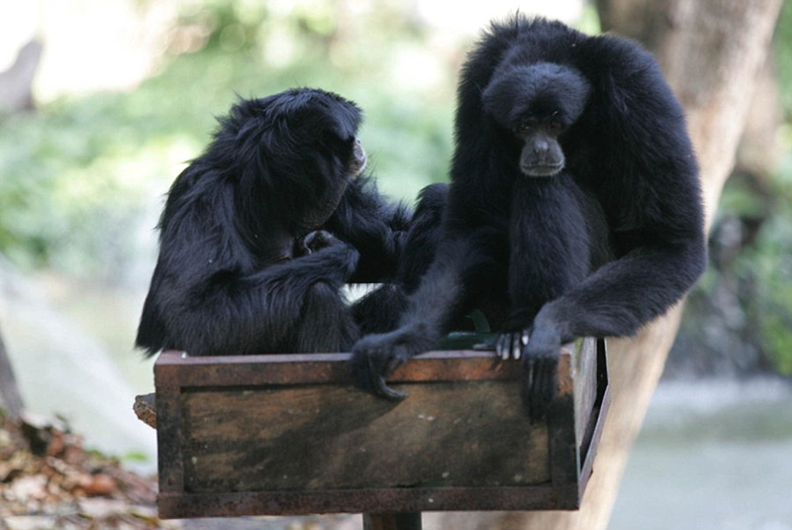
Notes:
Image 12 of the Photographic Evidence: In this picture it can be seen the face of sadness of one of the monkeys.

Slide 13
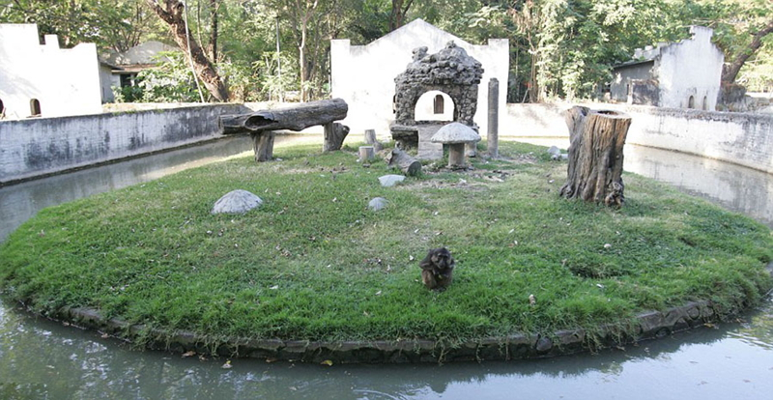
Notes:
Image 13 of the Photographic Evidence: In this picture we see a single monkey, which is isolated, without any tree to climb, without other companions of the same species and without access to food sources nearby. It is in a state of dissatisfaction.

Slide 14
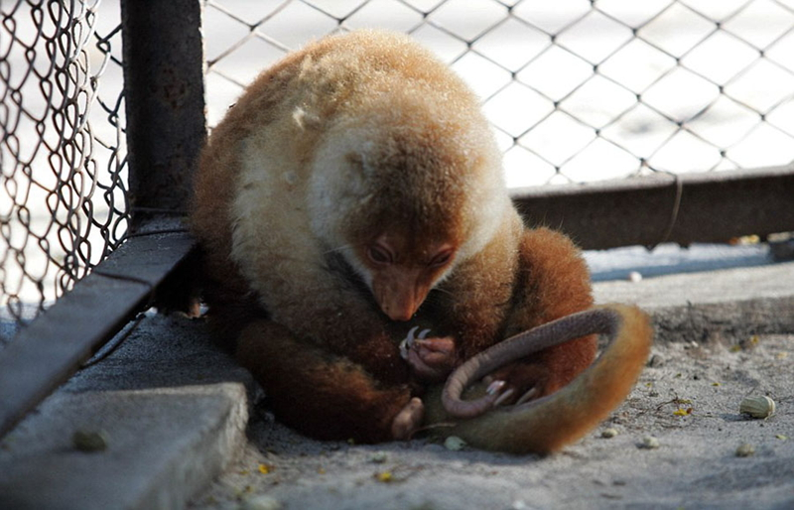
Notes:
Image 14 of the Photographic Evidence: In this photograph it can be appreciated what seems to be a species of lemur caged and looking sad due to the confinement.

Slide 15
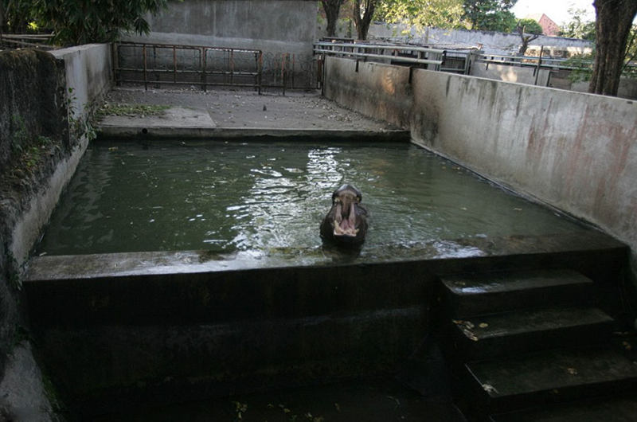
Notes:
Image 15 of the Photographic Evidence: In the image it can be seen a hippo that is in a very small place for its size.

Slide 16
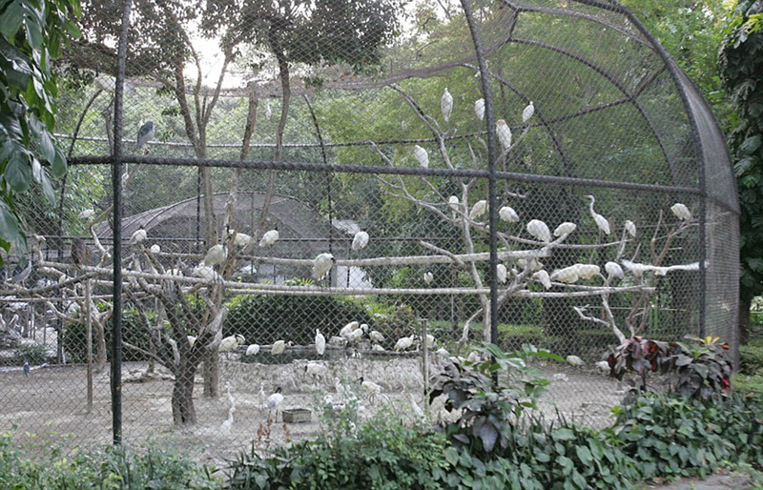
Notes:
Image 16 of the Photographic Evidence: Cage with overpopulation of herons, due to the lack of control in breeding the species.

Slide 17
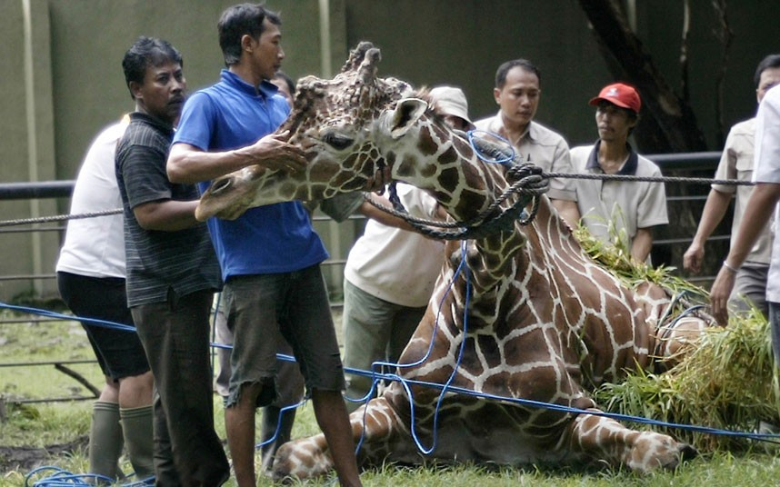
Notes:
Image 17 of the the Photographic Evidence: Kliwon, a giraffe died from ingesting food wrappers that visitors threw in its resting place. A ball of plastic materials weighing 18 kg was removed from his digestive tract after its death.

Slide 18
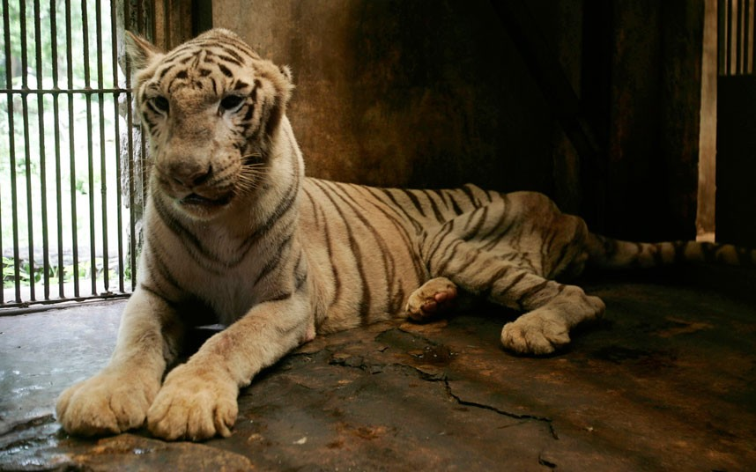
Notes:
Image 18 of the Photographic Evidence: A young white bengal tiger which is missing an ear and has complications in his spine, which impedes the movement of its hind legs. It is located in the section of quarantined animals and the cage it dwells is in unhygienic condition with very limited space.

Slide 19
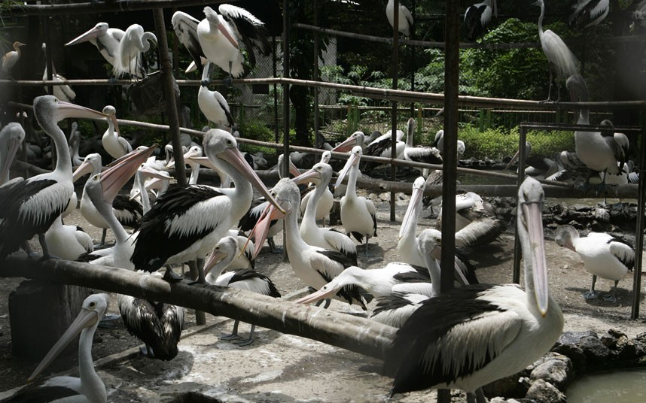
Notes:
Image 19 of the Photographic Evidence: Image of the cage of pelicans, where can be seen the reduced space and the surplus of birds.

Slide 20
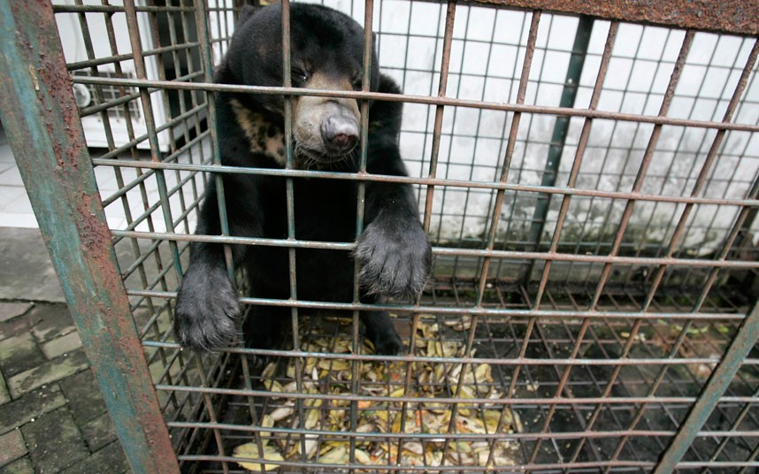
Notes:
Image 20 of the photographic evidence: In this photograph it can be observed a bear, which was diagnosed with a tumor in the skin, being in a tiny cage in the quarantined animals section of the zoo. It can also be seen its face that denotes suffering because of the enclosure and the poor care it receives.

Slide 21
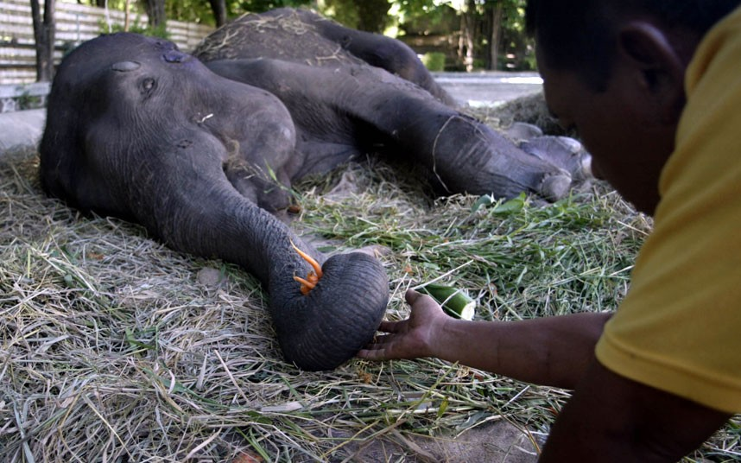
Notes:
Image 21 of the Photographic Evidence: in this image it can be seen a female elephant with inflammation of the joints, which is hindered from moving because of the pain it suffers.

Slide 22
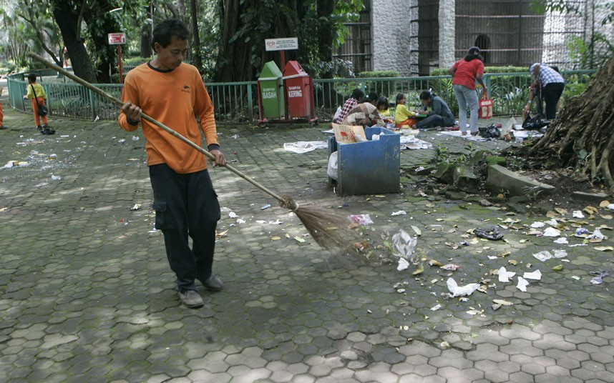
Notes:
Image 22 of the Photographic Evidence: It can be observed dirt conditions in which the zoo is after having been visited at least by 7,000 people a day. Many of these wastes end up being eaten by monkeys circulating around the zoo.

Slide 23
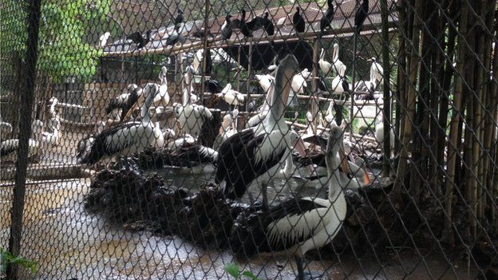
Notes:
Image 23 of the Photographic Evidence: Image of the cage of the pelicans, which is prepared for a much smaller amount of them.

Slide 24
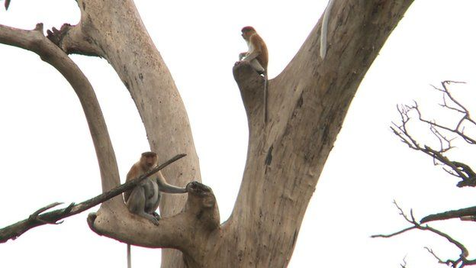
Notes:
Image 24 of the Photographic Evidence: In this photo it can be seen some monkeys climbing on few dead trees, which have no leaves to ward off rain or storms or any fruit that are a staple food of these animals. They are in an island.

Slide 25
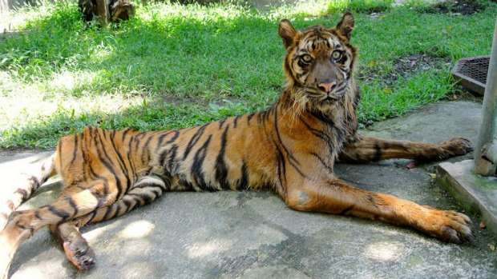
Notes:
Image 25 of the Photographic Evidence: In this picture it can be seen a female Sumatran tiger, which suffers a digestive disease because of years of being fed with meat preserved with formaldehyde (formalin), which is highly toxic to ingestion. This animal has difficulty in assimilating any food that eats, even if they are small pieces of chicken. It has been in such state for years and the person in charge its care claims that years ago it should have been injected with euthanasia due to physical deterioration in which it is, the damage is irreversible since that malaise generates much suffering to the animal.

Slide 26
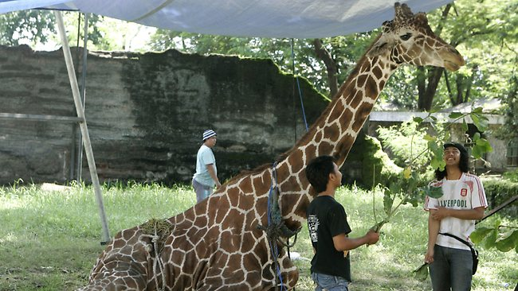
Notes:
Image 26 of Photographic Evidence: Kliwon, the Giraffe to which, after dead, was found a ball of plastic wrappings of 18 kg. in its stomach, because of years of having ingested bags or food wrappers that were thrown by visitors.

Slide 27
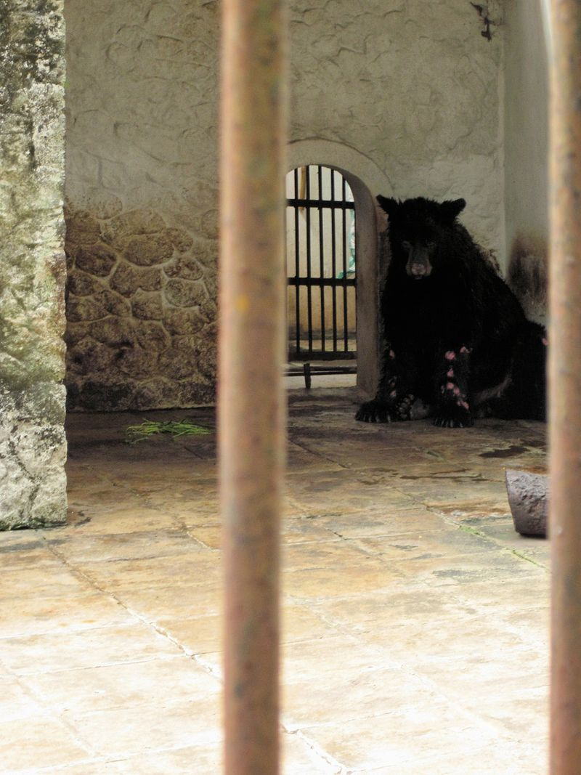
Notes:
Image 27 of the Photographic Evidence: In the picture it can be seen an American bear that is in a totally inadequate cage for an animal of its species. In its front legs they can be noticed the damages because of a skin disease, characteristic of animals locked in inadequate cages, with a lousy care. Moreover, its face shows sadness and discomfort.

Slide 28
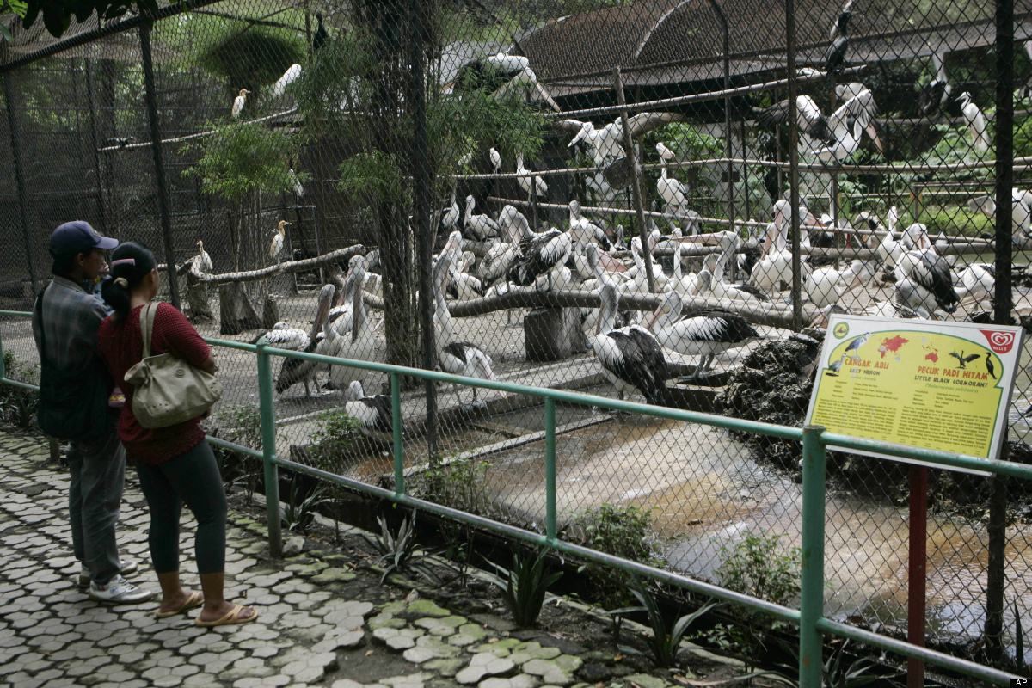
Notes:
Immage 28 of the Photographic Evidence: Another image of the cage with surplus of birds (pelicans).

Slide 29
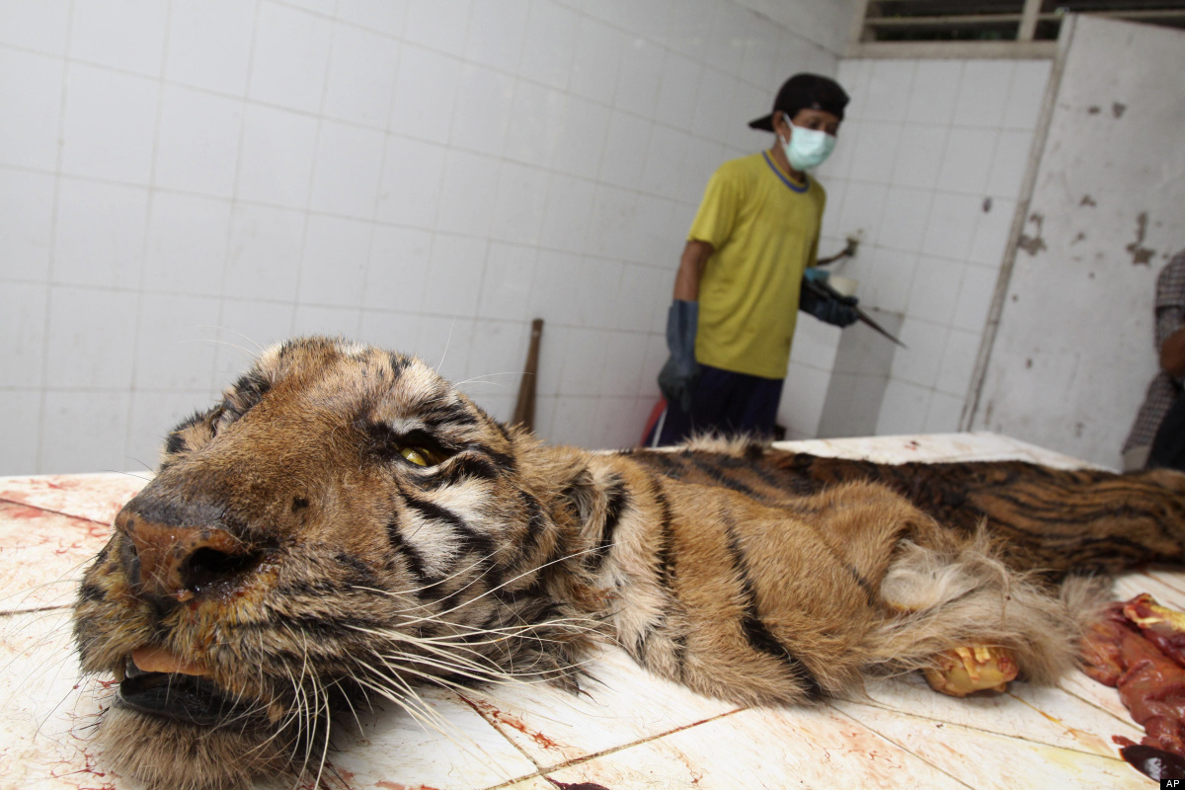
Notes:
Image 29 of the Photographic Evidence: Photo of a tiger that was found dead in its cage and to which they are skinning in order to preserve their skins.

Slide 30
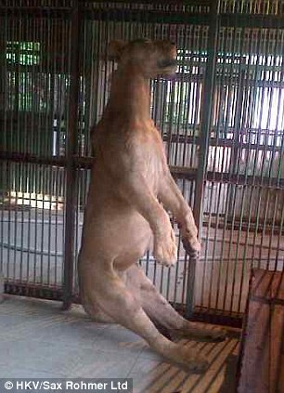
Notes:
Image 30 of the Photographic Evidence: An 18-month lion that was found hanging from a cable in its cage.

Slide 31
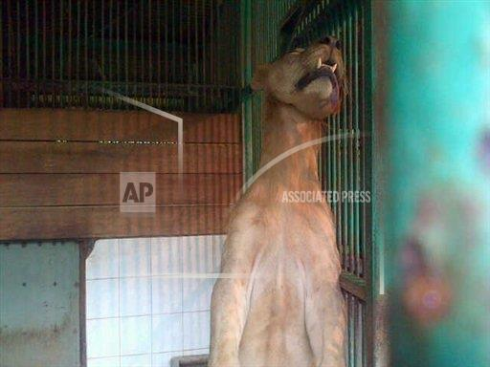
Notes:
Image 31 of the Photographic Evidence: Image of Michael, the lion found hanged in its cage. There are reports that the animal was removed from the place before investigators arrive and its corpse cannot be found yet, something that hinders investigation in order to determine the causes of its death.

